Slide 1
SIMPLE LINEAR REGRESSION & CORRELATION
OSAMA BIN AJAZ
Lecturer at FAST-NUCES

Slide 2
Introduction
In previous chapters we have introduced two areas of inferential statistics, hypothesis testing & Confidence intervals.
Another area of inferential statistics involves determining whether a relationship between two or more numerical or quantitative variables exists. For example:
A businessperson may want to know whether the volume of sales for a given month is related to the amount of advertising the firm does that month.
Educators are interested in determining whether the number of hours a student studies is related to the student’s score on a particular exam.

Slide 3
Introduction
Medical researchers are interested in questions such as “Is caffeine related to heart damage?” or “Is there a relationship between a person’s age and his or her blood pressure?”
A zoologist may want to know whether the birth weight of a certain animal is related to its life span.
These are only a few of the many questions that can be answered by using the techniques of correlation and regression analysis.

Slide 4
Correlation is a statistical method used to determine whether a relationship between variables exists.
The purpose of this chapter is to answer the following questions statistically:
1. Are two or more variables related?
2. If so, what is the strength of the relationship?
3. What type of relationship exists?
4. What kind of predictions can be made from the relationship?
Introduction

Slide 5
In simple correlation and regression studies, the researcher collects data on two numerical or quantitative variables to see whether a relationship exists between the variables. For example:
if a researcher wishes to see whether there is a relationship between number of hours studied and test scores on an exam as shown:
Introduction

Slide 6
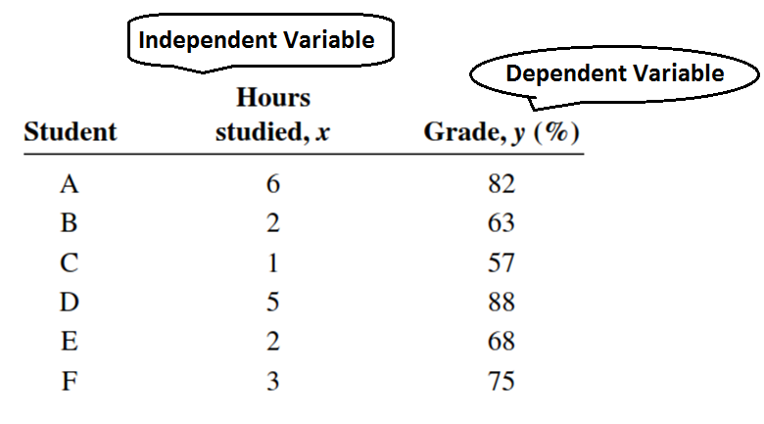
The independent variable is the variable in regression that can be controlled or manipulated.
The dependent variable is the variable in regression that cannot be controlled or manipulated.
Introduction

Slide 7
Scatter Plot
The independent and dependent variables can be plotted on a graph called a scatter plot. The independent variable, x, is plotted on the horizontal axis and the dependent variable, y, is plotted on the vertical axis.

Slide 8
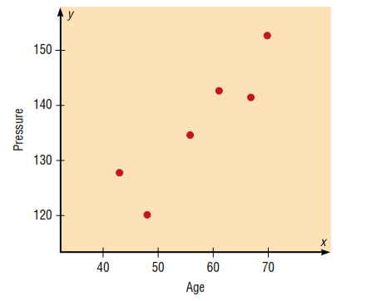
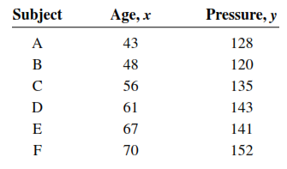
Scatter plot (Example 01)
Construct a scatter plot for the data obtained in a study of age and systolic blood pressure of six randomly selected subjects. The data are shown in the following table.

Slide 9
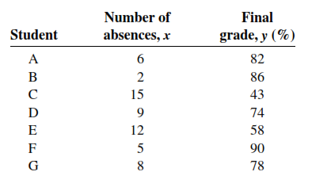
Scatter plot (Example # 02)
Construct a scatter plot for the data obtained in a study on the number of absences and the final grades of seven randomly selected students from a statistics class.

Slide 10
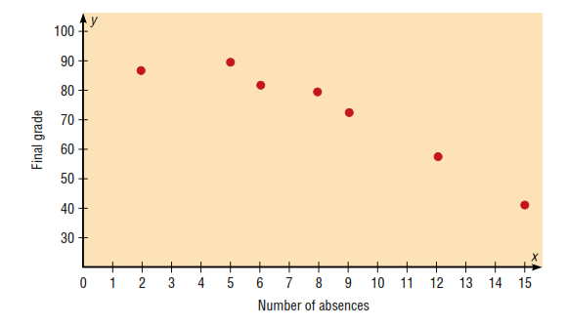
Scatter plot (Example # 02, Contd.)

Slide 11
Correlation Coefficient
to determine the strength of the relationship between two variables. There are several types of correlation coefficients. The one explained in this section is called the Pearson product moment correlation coefficient (PPMC), named after statistician Karl Pearson, who pioneered the research in this area.
The correlation coefficient computed from the sample data measures the strength and direction of a linear relationship between two variables. The symbol for the sample correlation coefficient is r. The symbol for the population correlation coefficient is ρ (Greek letter rho).
Correlation

Slide 12
Properties of Correlation Coefficient
Correlation coefficient is symmetric rxy = ryx.
Correlation coefficient does not depend on units.
The correlation coefficient lies between – 1 to + 1 i.e. – 1 ≤ r ≥ +1
Correlation

Slide 13
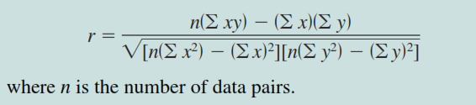
Formula for Correlation Coefficient
Correlation

Slide 14
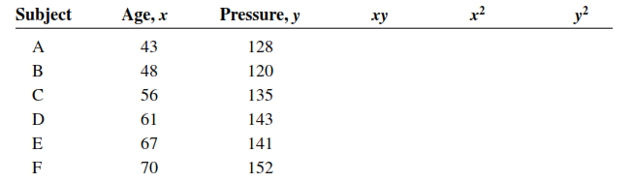
Example # 03
Compute the value of the correlation coefficient for the data obtained in the study of age and blood pressure:
Correlation

Slide 15
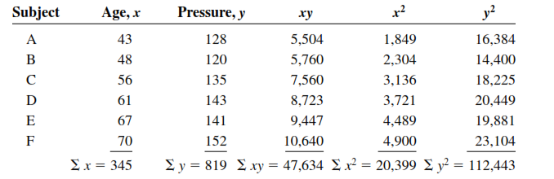
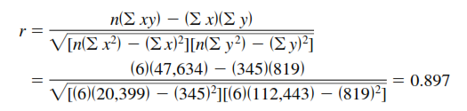
Example # 03 (contd.)
The correlation coefficient suggests a strong positive relationship between age and blood pressure.
Correlation

Slide 16
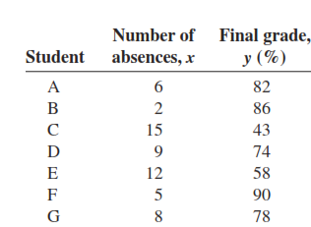
Example # 04
Compute the value of the correlation coefficient for the data obtained in the study of the number of absences and the final grade of the seven students in the statistics class:
Correlation

Slide 17
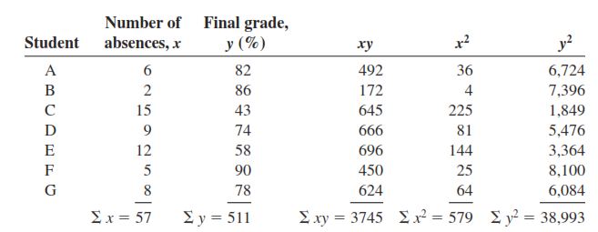
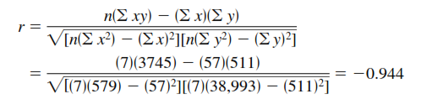
Example # 04 (Contd.)
Correlation

Slide 18
The Significance of Correlation
Since the value of r is computed from data obtained from samples, there are two possibilities when r is not equal to zero: either the value of r is high enough to conclude that there is a significant linear relationship between the variables, or the value of r is due to chance.
In order to make this decision, one uses a hypothesis-testing procedure.
Correlation

Slide 19
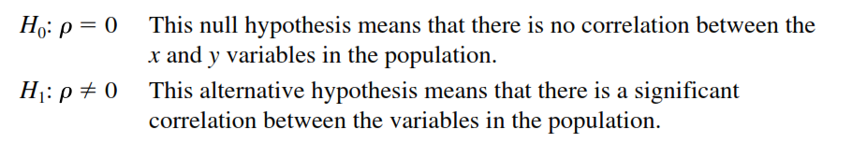
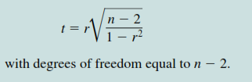
Hypothesis testing for Correlation
Correlation

Slide 20
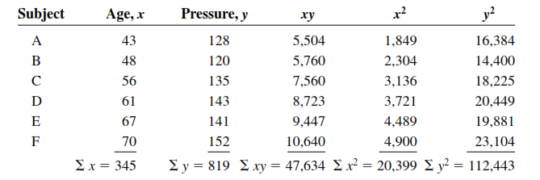
Example # 05
Test the significance of the correlation coefficient found in Example # 01.
Correlation

Slide 21


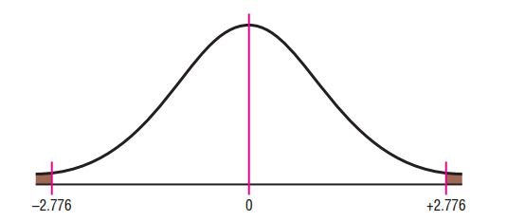
Example # 05 (Contd.)
Correlation

Slide 22
Possible relationship b/w variables
When the null hypothesis has been rejected for a specific value, any of the following four possibilities can exist.
There is a direct cause-and-effect relationship between the variables. That is, x causes y. For example, water causes plants to grow, poison causes death, and heat causes ice to melt.
There is a reverse cause-and-effect relationship between the variables. That is, y causes x. For example, suppose a researcher believes excessive coffee consumption causes nervousness, but the researcher fails to consider that the reverse situation may occur. That is, it may be that an extremely nervous person craves coffee to calm his or her nerves.
The relationship between the variables may be caused by a third variable
Remember, correlation does not necessarily imply causation.
Correlation

Slide 23
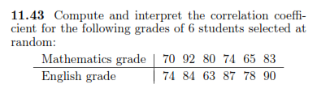

Practice Questions for Correlation
Correlation

Slide 24

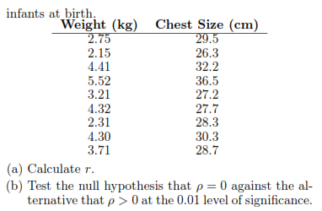
Practice Questions for correlation (Contd.)
Correlation

Slide 25
Simple Linear Regression
In studying relationships between two variables:
collect the data and then construct a Scatter plot.
compute the value of the correlation coefficient.
test the significance of the relationship.
If the value of the correlation coefficient is significant, the next step is to determine the equation of the regression line, which is the data’s line of best fit.
Determining the regression line when r is not significant and then making predictions using the regression line is meaningless.

Slide 26
Simple Linear Regression (Contd.)
The dependence of one variable over the other variable is called “Regression”.
The statistical method which helps us to estimate the value of dependent variable from the known value of independent variable is called regression.
Simple Linear Regression

Slide 27
Sir Francis Galton coined the term “Regression”. He studies heights of 100 fathers & sons and find that
tall fathers having tall sons & short father having short sons.
Average height of sons of tall fathers < Avg. height of tall fathers.
Avg. height of the sons of short fathers > Avg. height of the short fathers.
This tendency to regress towards the average height of general population was described by him as Regression.
Simple Linear Regression

Slide 28
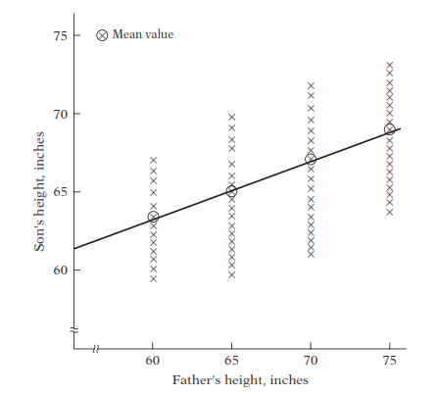
Hypothetical example for Francis Galton’s Law
Simple Linear Regression

Slide 29

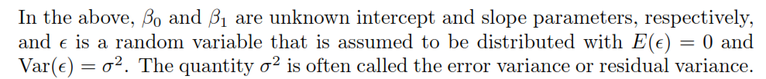
Simple Linear Regression Model
The statistical model for simple linear regression is given below. The response Y is related to the independent variable x through the equation:
Simple Linear Regression

Slide 30
The quantity Y is a random variable since is ϵ random.
The value x of the regressor variable is not random and, in fact, is measured with negligible error.
The quantity ϵ, often called a random error or random disturbance, has constant variance (homogeneous variance).
The presence of this random error, , keeps the model from becoming simply a deterministic equation.
Simple Linear Regression

Slide 31
We must keep in mind that:
in practice ß0 and ß1 are not known and must be estimated from data.
we never observe the actual ϵ values in practice and thus we can never draw the true regression line
We can only draw an estimated line.
Simple Linear Regression

Slide 32
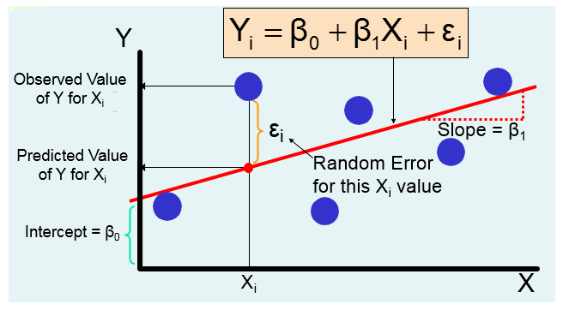
Simple Regression Model (Contd.)

Slide 33
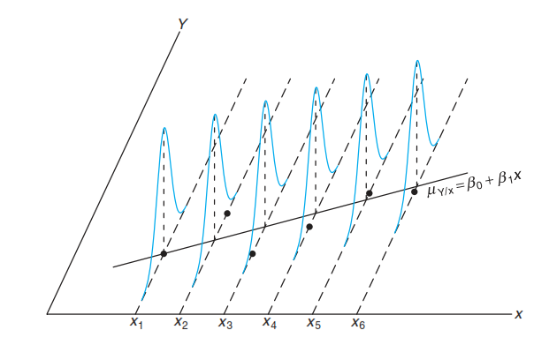
Assumptions of Regression Model

Slide 34
Deterministic Vs. Statistical Relationship
in regression analysis we are concerned with what is known as the statistical, not deterministic dependence among variables.
In statistical relationships among variables we essentially deal with random or stochastic variables i.e. variables that have probability distributions.
Simple Linear Regression

Slide 35

Deterministic Vs. Statistical (Example)
The dependence of crop yield on temperature, rainfall, sunshine, and fertilizer, for example, is statistical in nature in the sense that the explanatory variables, although certainly important, will not enable the agronomist to predict crop yield exactly.
In deterministic phenomena, on the other hand, we deal with relationships of the type, say, exhibited by Newton’s law of gravity, which states: Every particle in the universe attracts every other particle with a force directly proportional to the product of their masses and inversely proportional to the square of the distance between them.
Simple Linear Regression

Slide 36
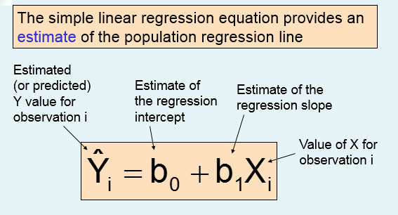
Simple Linear Regression

Slide 37
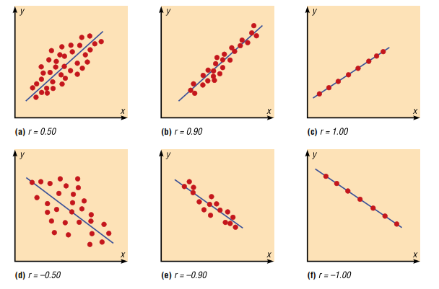

Relationship B/w Regression & Correlation
The value of the correlation coefficient can also be found by using the formula:

Slide 38
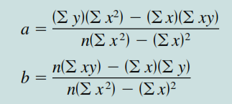
Determining Regression Equation
There are several methods for estimating the regression parameters, here we will use Method of Least Sq. to estimate the parameters.
The formula for parameters estimation by least square is given below:
Simple Linear Regression

Slide 39
The Method of Least Squares
We shall find b0 and b1, so that the sum of the squares of the residuals is a minimum.
The residual sum of squares is often called the sum of squares of the errors about the regression line and is denoted by SSE.
This minimization procedure for estimating the parameters is called the method of least squares
Simple Linear Regression

Slide 40
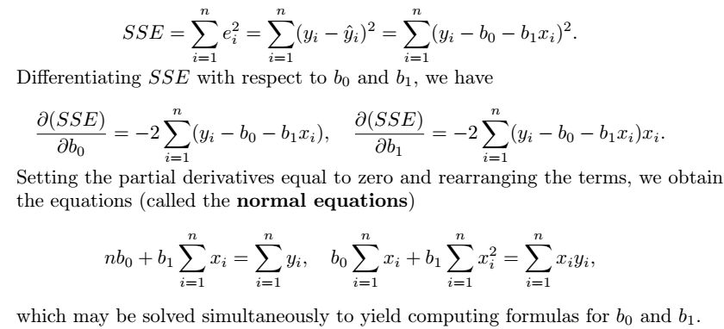
The Method of Least Squares (Contd.)
We have considered bo = a & b1 = b (see slide 38)
Simple Linear Regression

Slide 41
Example # 06
Find the equation of the regression line for the data in Example # 01 (Slide 15), and graph the line on the scatter plot of the data.

Slide 42
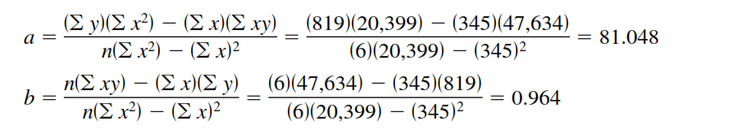

Example # 06 (Contd.)
The sign of the correlation coefficient and the sign of the slope of the regression line will always be the same. The reason is that the numerators of the formulas are the same.
Simple Linear Regression

Slide 43
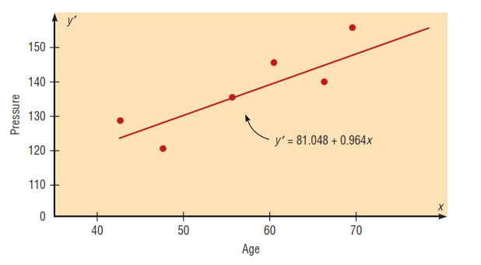
Simple Linear Regression

Slide 44
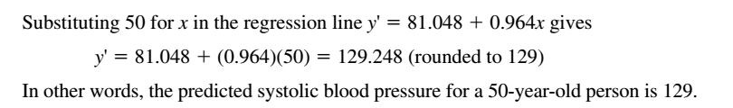
Prediction Using Regression Eq.
Using the equation of the regression line found in Example # 06, predict the blood pressure for a person who is 50 years old.
Simple Linear Regression

Slide 45
Assumptions for valid prediction
For any specific value of the independent variable x, the value of the dependent variable y must be normally distributed about the regression line.
The standard deviation of each of the dependent variables must be the same for each value of the independent variable.
Simple Linear Regression

Slide 46
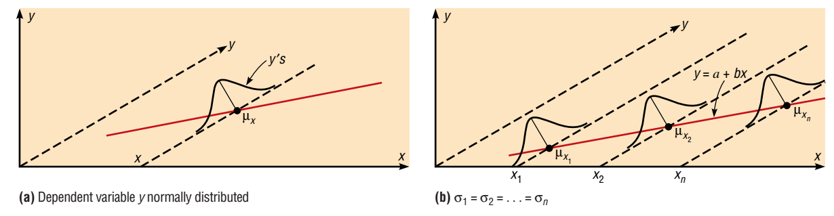
Assumptions for Prediction
Simple Linear Regression

Slide 47
Example # 07
Consider the experimental data given below, which were obtained from 33 samples of chemically treated waste in a study conducted at Virginia Tech. Readings on x, the percent reduction in total solids, and y, the percent reduction in chemical oxygen demand, were recorded. Estimate the regression line for the pollution data.
Simple Linear Regression

Slide 48
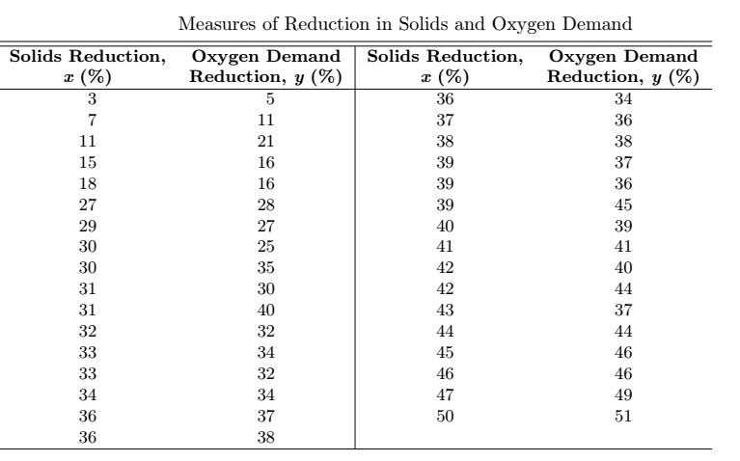

Example # 07 (Contd.)
Simple Linear Regression

Slide 49
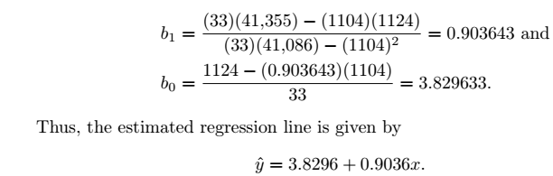
Example # 07 (Contd.)
Simple Linear Regression

Slide 50
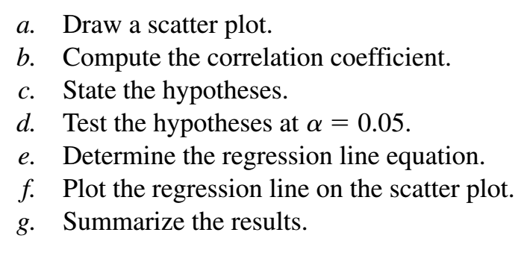
Practice questions
Do a complete regression analysis by performing the following steps for Q1 & Q2. (See Next Slide)
Simple Linear Regression

Slide 51
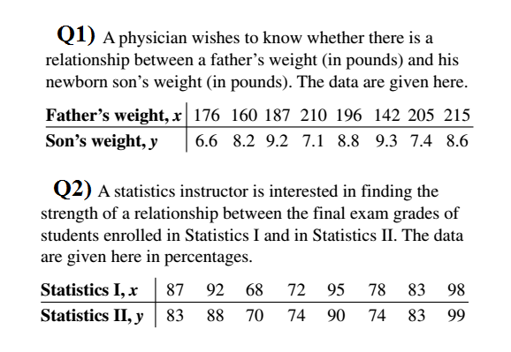
Simple Linear Regression

Slide 52
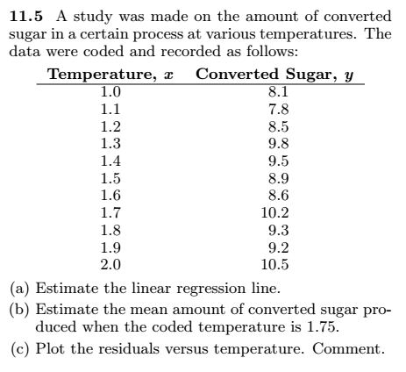
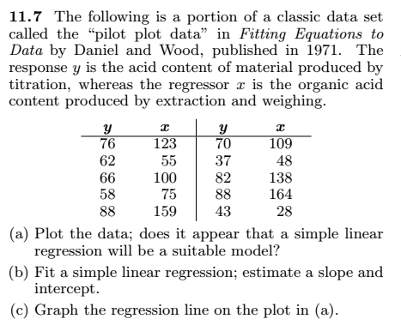
Practice Questions
Simple Linear Regression

Slide 53
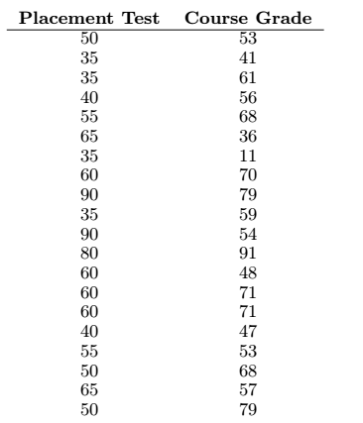
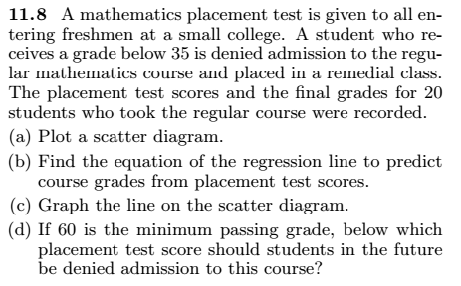
Practice Questions
Simple Linear Regression

